Slide 1

BLOCKCHAIN
Guna Chandrasekaran
Ayush Kale
Luigi Manalac

Slide 2
Roadmap
What is Blockchain?
Blockchain Architecture.
Blockchain Transaction Process.
Components of Blockchain.
Blockchain Applications.

Slide 3


What is Blockchain?

Slide 4


PEER TO PEER.
DeCentralized:
No authority.
No intermediate.

Slide 5



BLOCK:
COLLECTION OF BLOCKS IS A LEDGER
LEDGER:

Slide 6
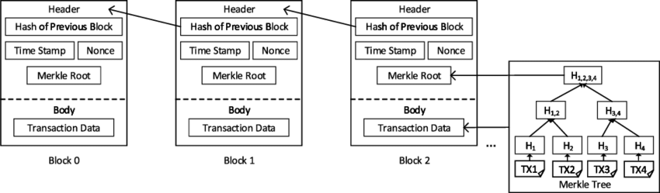
Block Structure
Notes:
Previous Hash block - 256 bit hash value that points to the prev block
Merkle tree root - hash value of all the transactions in the block
Timestamp - indicates when the block is created
Nonce - 4 byte field usually start with 0 and increases for every hash calculation

Slide 7

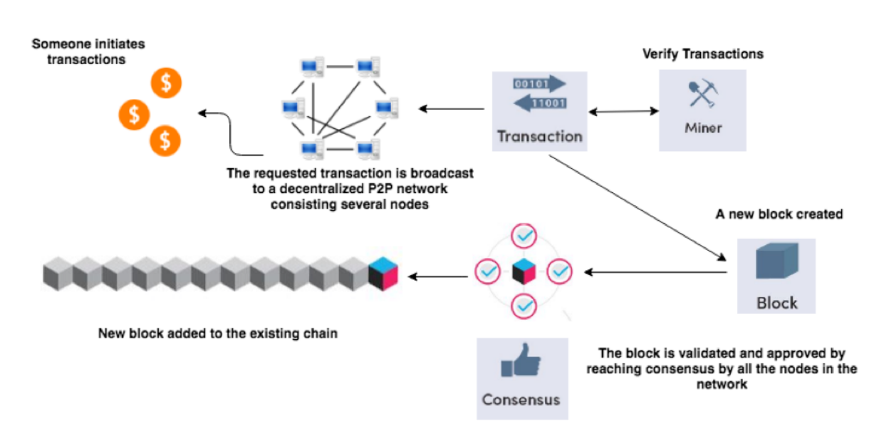
Blockchain Network

Slide 8
Blockchain transaction process:
Cryptographic Hash function.(mining and consensus mechanism).
example:Bitcoin uses a 256 bits’ secure hash algorithm
known as SHA-256 [25].
It produce 256 bits or the 64 characters
output called hash [26]. (ONE WAY FUNCTION,INPUT TO OUTPUT)
IDENTITY :
The transaction between the sender and the receiver is requested by the sender, and not by anyone else.

Slide 9



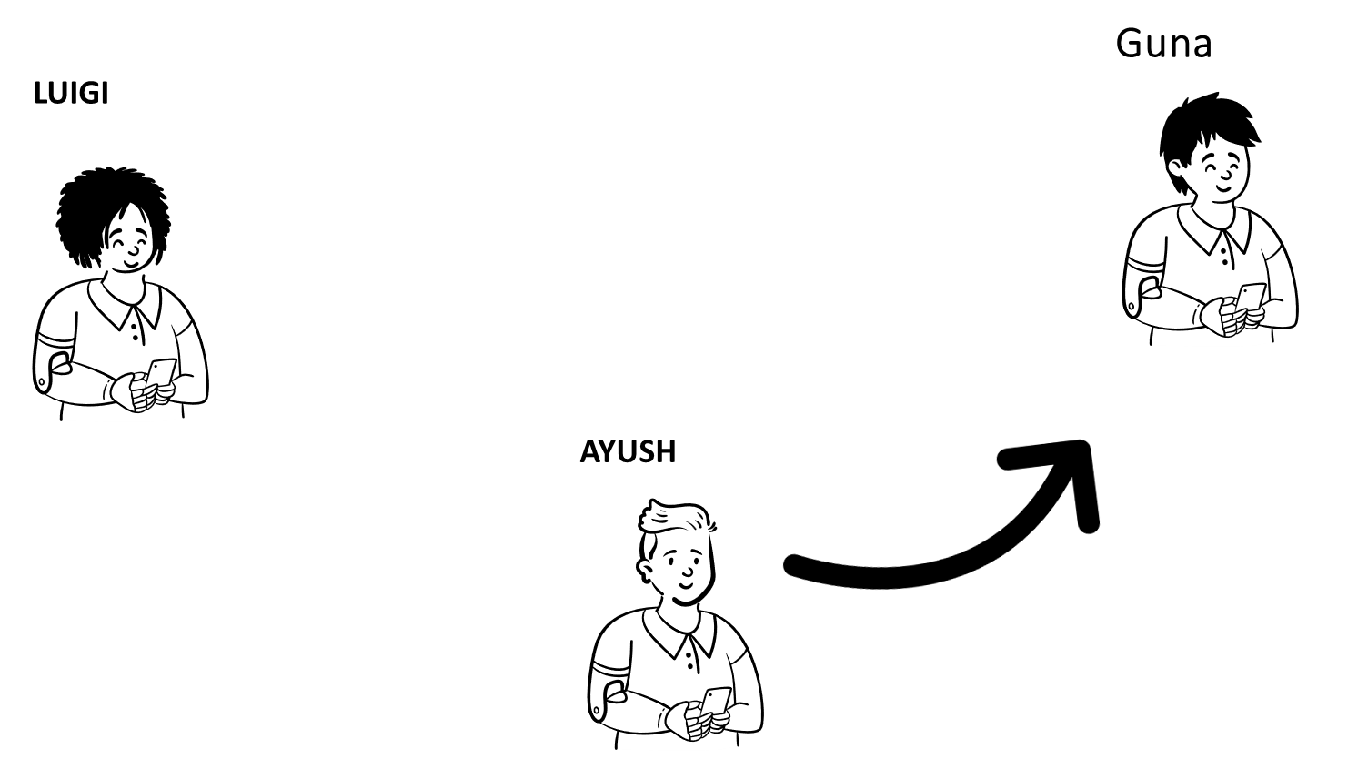


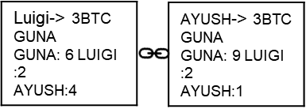


Luigi-> 3BTC GUNA GUNA: 6 LUIGI :2 AYUSH:4
AYUSH-> 3BTC GUNA GUNA: 9 LUIGI :2 AYUSH:1

Slide 10







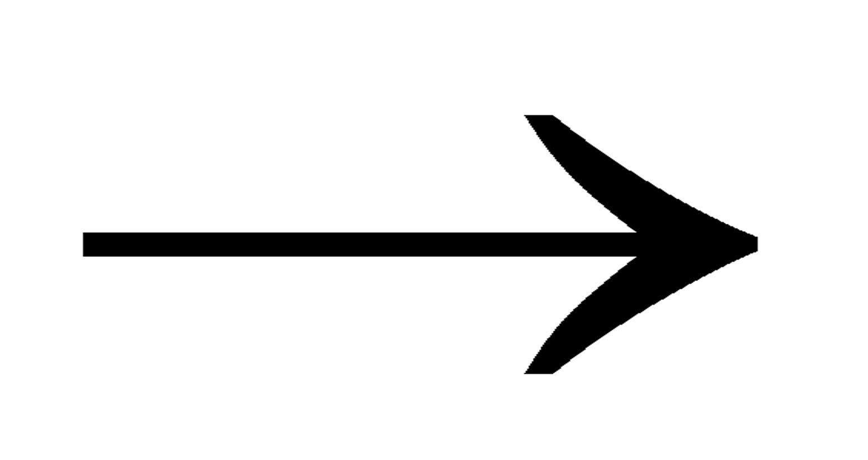

Luigi -> Guna 2btc
Their wallet address.
Encrypted and digitally signed
#
Signature in each transaction contains 256 bits.

Slide 11
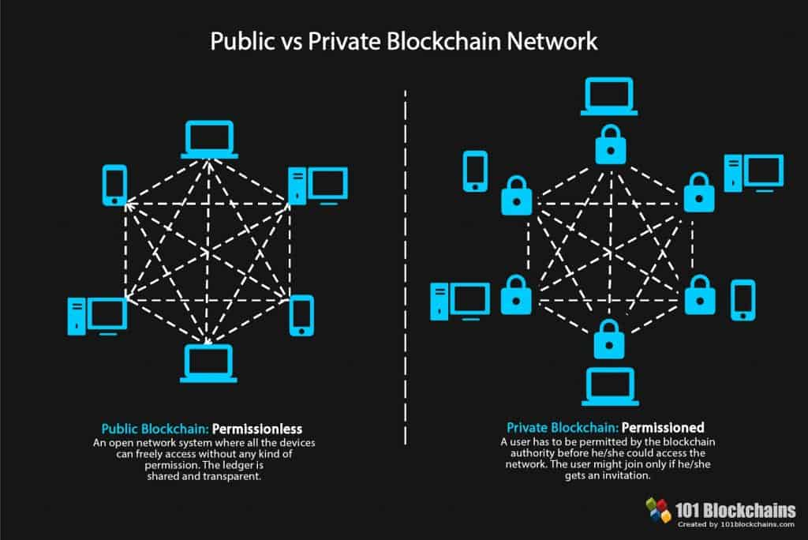
BlockChain Categorization:

Slide 12
Also Known As | Public, Trustless | Private, Permissioned Sandbox
Key Attributes | Full transparency Development in Open Source Mostly Anonymous Privacy dependent on technological limitations No Control Authority Involves digital assets | Controlled Transparency Development by Private entities Not anonymous Privacy based on governance decision No Single authority May or May not involve digital assets.
Benefits | Brader decentralization Highly transparent Censorship resistant Security resilience | Incremental Decentralization Strong privacy Customizable Faster and Scalable.
Drawback | Less energy efficient Slow and difficult to scale Less user privacy | Limited decentralization Override risk Less transparent

Slide 13
COMPONENTS OF BLOCKCHAIN: CRYPTOGRAPHY. CONSENSUS.

Slide 14

Cryptography:

Slide 15
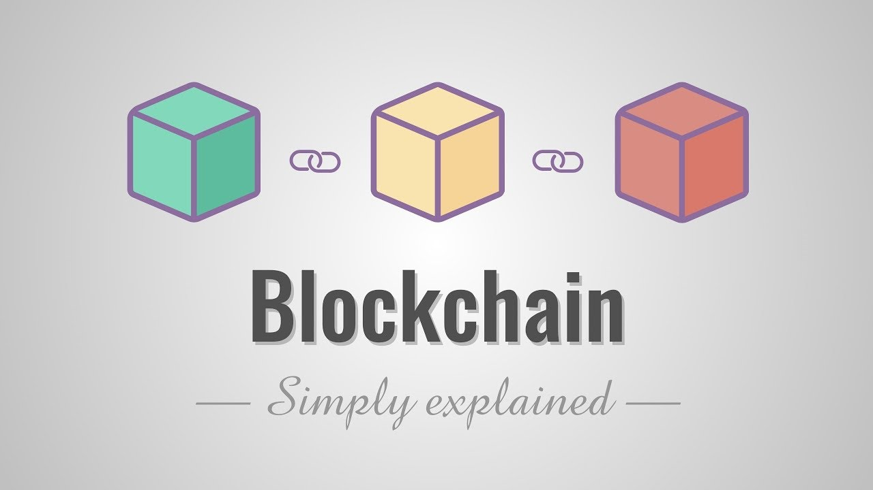

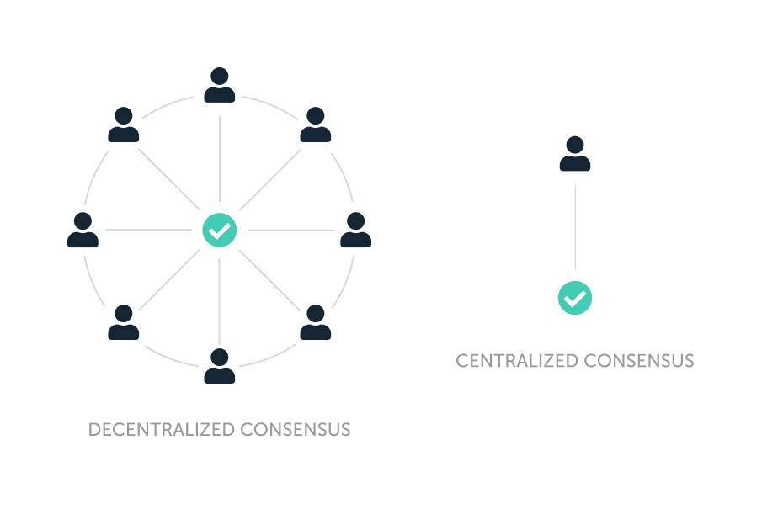
Append-Only
Timestamped
Blockchain
Auditable Database
(Secured via Cryptography)
Consensus Protocols

Slide 16
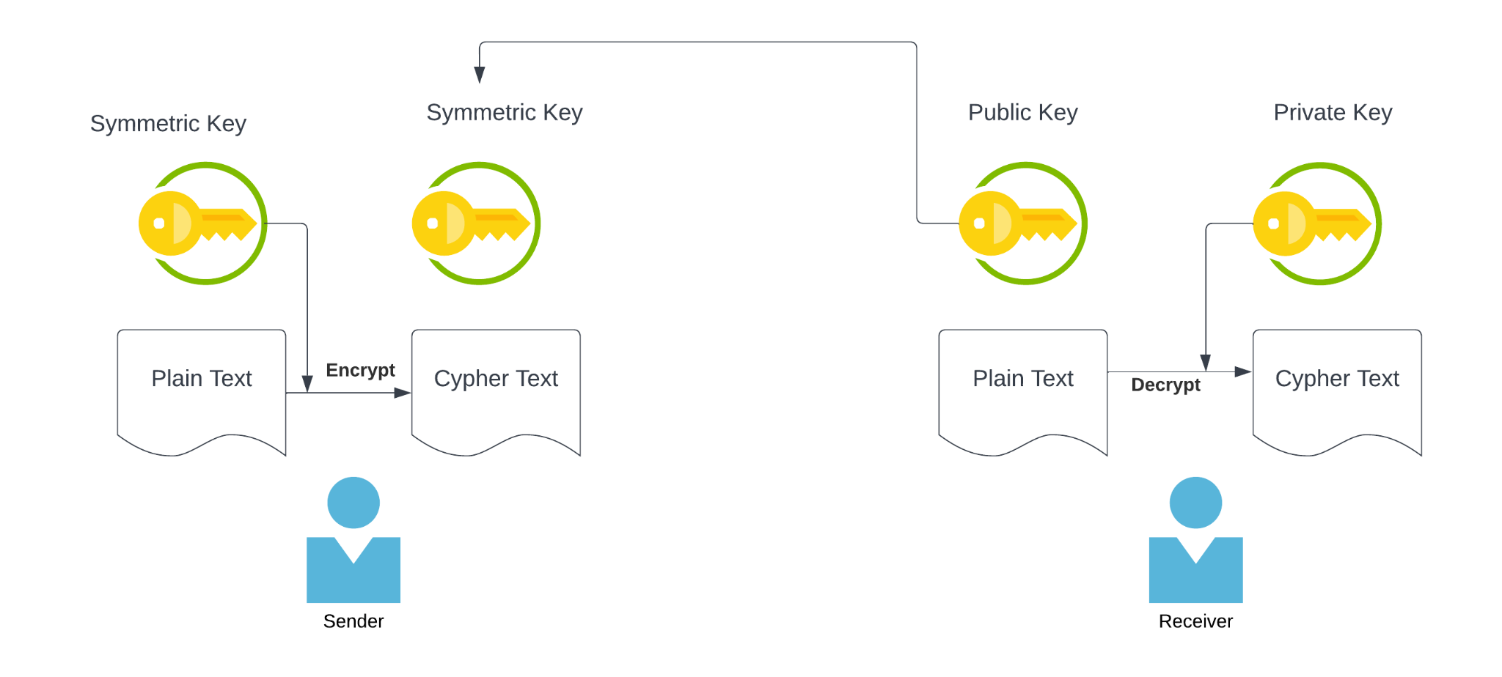
Public - Private Key Management

Slide 17
Criteria for Hashing Functions
Given hash function hash(), message m and hash value h
Preimage Resistance
If the hash value h = hash(m) is given it is very difficult to find a m for which h=hash(m)
Will take 2²⁵⁶ Operations(10⁷⁸ )
Collision Resistance
Nobody can find x, z such that x != z
hash(x) = = hash(z)
Will take 2¹²⁸ Operations

Slide 18
HASHES AS POINTERS AND REFERENCES
Hash is a data-field in a current block in the Blockchain.
Contains the hash of the previous block
Ensures that the contents of the previous block cannot be changed. Reliability Checks.
Examples
Implementation of Blockchain
Merkle Tree in Cryptocurrencies and Blockchain applications

Slide 19
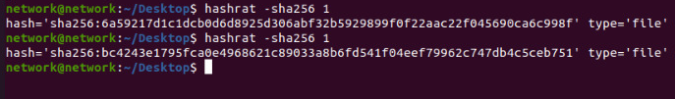
Examples of Hashing Functions
Hashing a Text File using sha256 hashing algorithm
When the contents of the file, “1.txt” is changed hash changes completely

Slide 20
Examples of Hashing Functions
sha 256 Hashing Algorithm
Hashing of integers 1 and 2 using sha256
sha 512 Hashing Algorithm

Slide 21
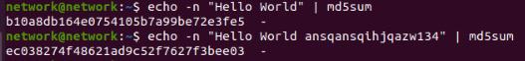
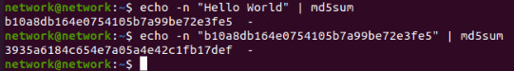
Examples of Hashing Functions
md5 Hashing Algorithm
Append extra data (randomly generated string or numbers) if the preimage is susceptible to guessing by adversaries
Hashing the preimage twice.To avoid Birthday Attacks. Example: Bitcoin

Slide 22
Block Header Attributes
Header Attributes | Definition
Block Version | Indicates which set of Block Validation Rules to follow
Previous Block Hash | Hash Value of previous block used as pointers
Merkle Tree Root | The hash value of all transactions in the block
nBits | Current Hashing Target
Nonce | A 4-byte field which starts with 0 and increases for every hash calculation

Slide 23
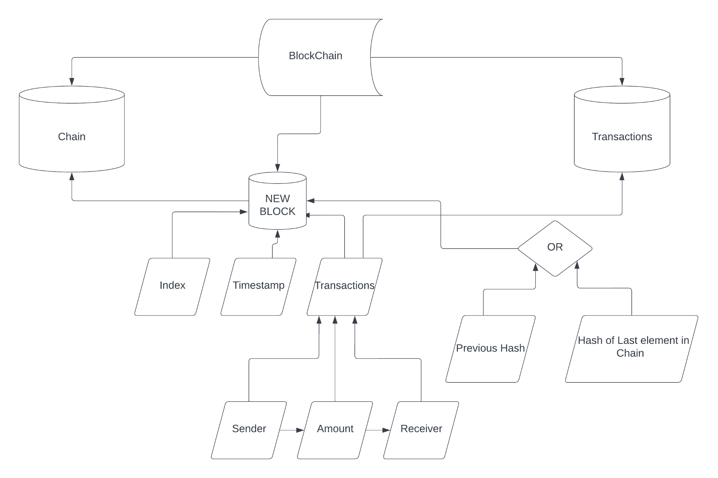
Implementation of BlockChain

Slide 24
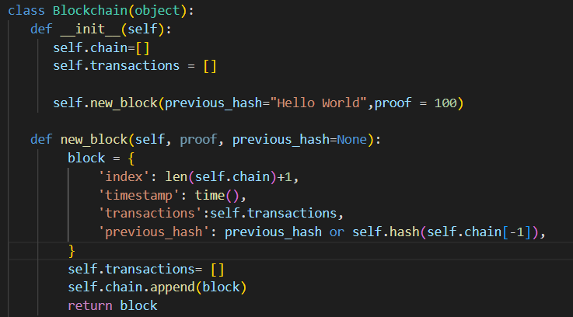
CLASS BLOCKCHAIN
Contains chain and transactions, 2 list variables
Function new_block to add to the class Blockchain
New_block contains index of the block, timestamp and hash of the last element of the list chain
Notes:
__init__ is one of the reserved methods in Python. In object oriented programming, it is known as a constructor.
The self in keyword in Python is used to all the instances in a class. By using the self keyword, one can easily access all the instances defined within a class, including its methods and attributes.

Slide 25
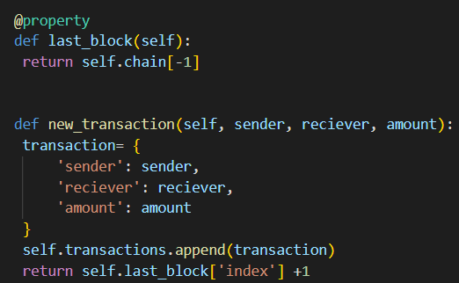
Properties of Class BLOCKCHAIN
last_block returns last element of the list chain in the class blockchain
New Transaction contains sender’s name, receiver’s name and Amount as string
It appends the new transactions to transactions list in Blockchain
Notes:
@Property is a built in function that returns a property object.

Slide 26
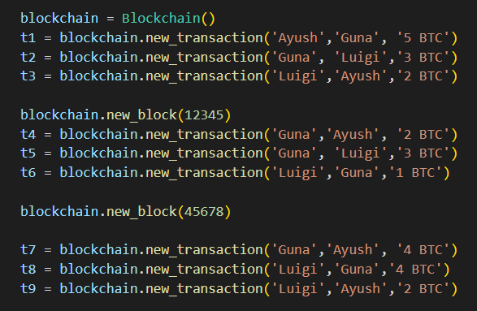
Transactions using BlockChain

Slide 27
OUTPUT FOR IMPLEMENTATION - CONTENTS OF BLOCKCHAIN
Blockchain:
[{'index': 1, 'timestamp': 1670141947.3699968, 'transactions': [], 'previous_hash': 'Hello World'},
{'index': 2, 'timestamp': 1670141947.3699968, 'transactions': [{'sender': 'Ayush', 'receiver': 'Guna', 'amount': '5 BTC'}, {'sender': 'Guna', 'receiver': 'Luigi', 'amount': '3 BTC'}, {'sender': 'Luigi', 'receiver': 'Ayush', 'amount': '2 BTC'}], 'previous_hash': '9295cbaab6945c33caa26be5bfde0b64d8b8feb7ed2236d54ac9f9cfa416347c'},
{'index': 3, 'timestamp': 1670141947.3699968, 'transactions': [{'sender': 'Guna', 'receiver': 'Ayush', 'amount': '2 BTC'}, {'sender': 'Guna', 'receiver': 'Luigi', 'amount': '3 BTC'}, {'sender': 'Luigi', 'receiver': 'Guna', 'amount': '1 BTC'}], 'previous_hash': 'f942eac85d61fc93e8d6ac5e2c5f729090094992e9512508a29a2160a9f44201'}]

Slide 28
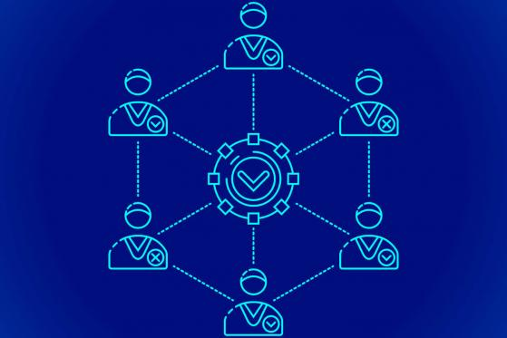
Consensus:

Slide 29
Consensus Procedures
Proof of Work (PoW)
Proof of Stake (PoS)
Delegate Proof of Stake (DPoS)
Practical Byzantine Fault Tolerance (PBFT)
Tendermint

Slide 30
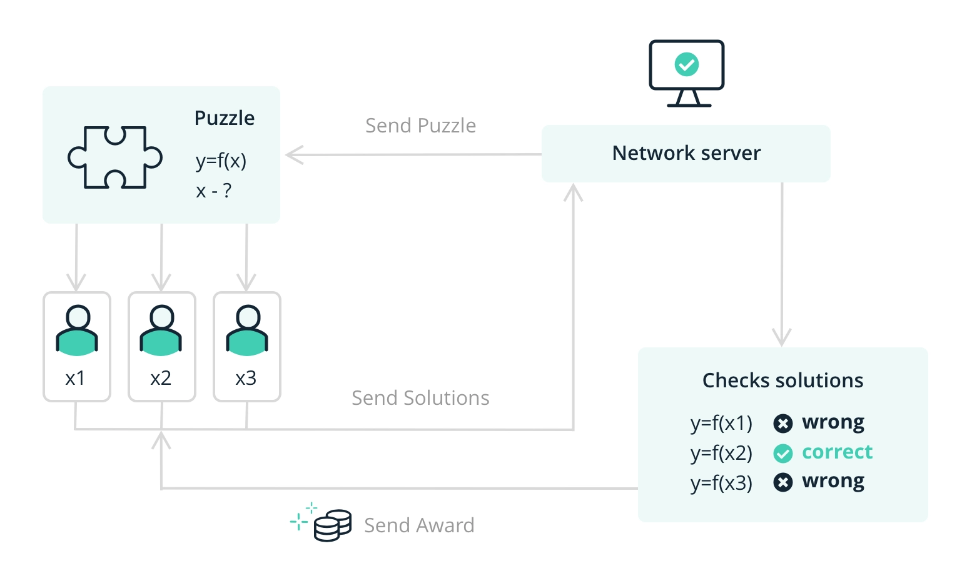
Proof of Work (PoW)
Notes:
PoW - created on 2009 by BItCoin
miners compete to solve a complex computational puzzles to produce the next block and broadcast it to the network, which is produced every 10 minutes. Then rewarded with 12.5 BTC
Helps to protect the network against different types of attacks. Successful attack would require a lot of computational power and time.
Cost of attack > Potential reward for attacking the network
Issue:
Mining requires expensive computer hardware that consumes large amounts of power

Slide 31
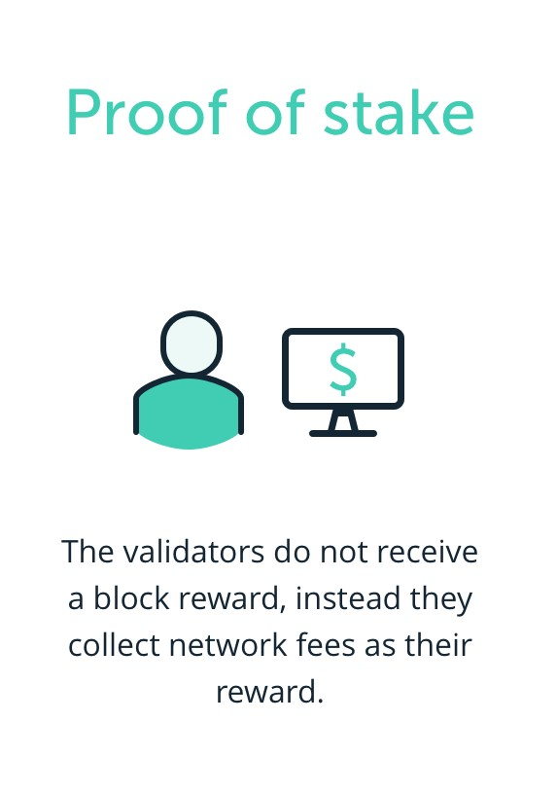
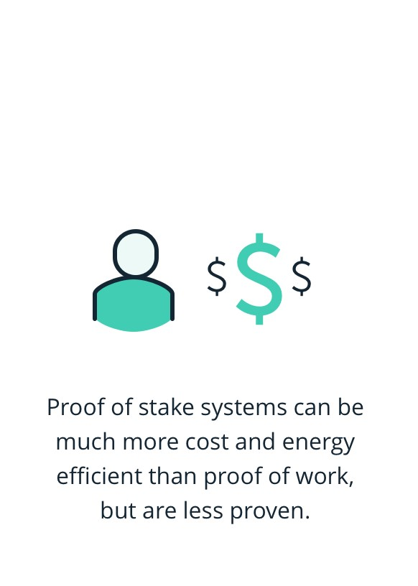
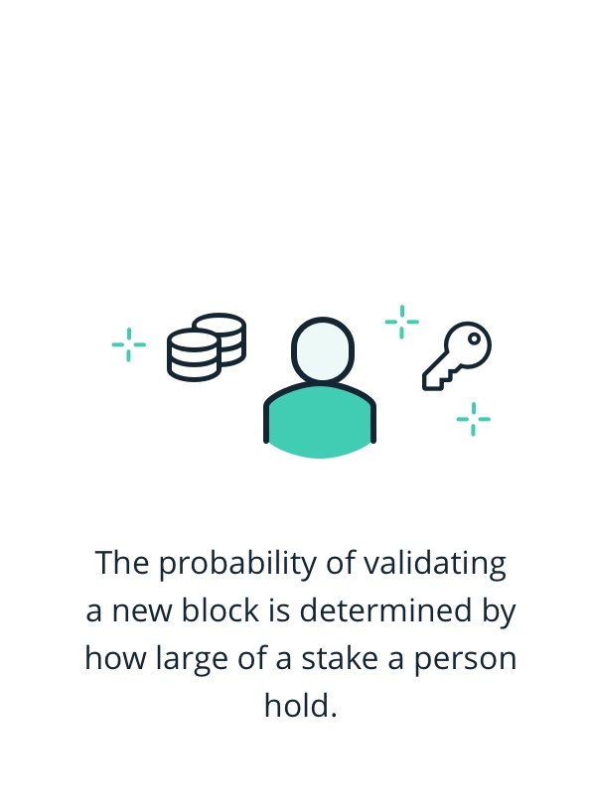
Proof of Stake (PoS)
Notes:
PoS - introduced in 2011
a validator is chosen randomly, based in part on how many coins they have locked up in the blockchain network. The size of the stake determines the chances for a node to be selected as the next validator
2 Methods:
Randomized Block Selection
- validators are selected by looking for node with the combination of lowest hash value and highest stake
Coin Age Selection
- chooses nodes based on how long their coins have been staked for
No. of days staked X No. of Coins staked

Slide 32
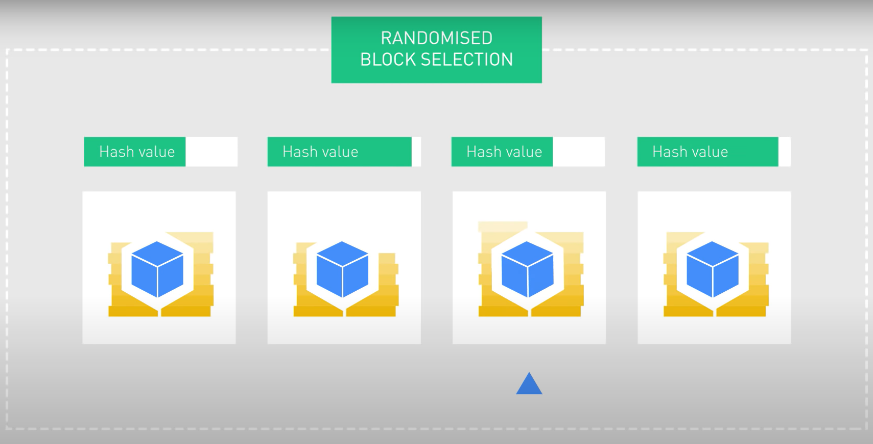
Proof of Stake (PoS)
Randomized Block Selection
Notes:
Randomized Block Selection
- validators are selected by looking for node with the combination of lowest hash value and highest stake

Slide 33
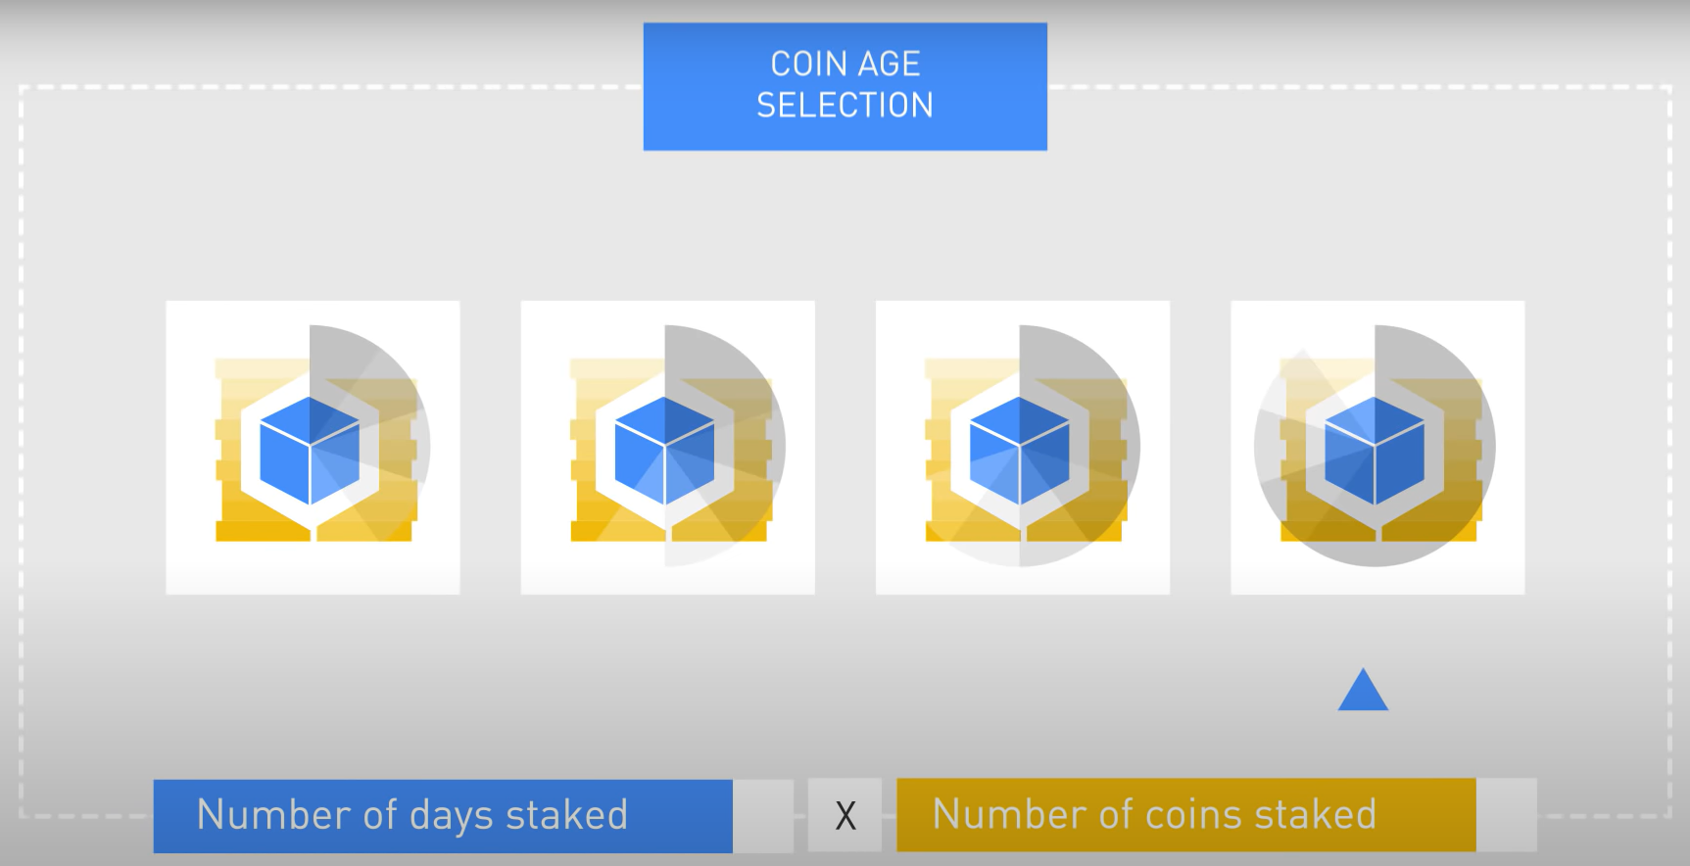
Proof of Stake (PoS)
Coin Age Selection
Notes:
Coin Age Selection
- chooses nodes based on how long their coins have been staked for
No. of days staked X No. of Coins staked
Once the nodes has forged a block their coin age is reset to zero and must wait a certain amount of time

Slide 34
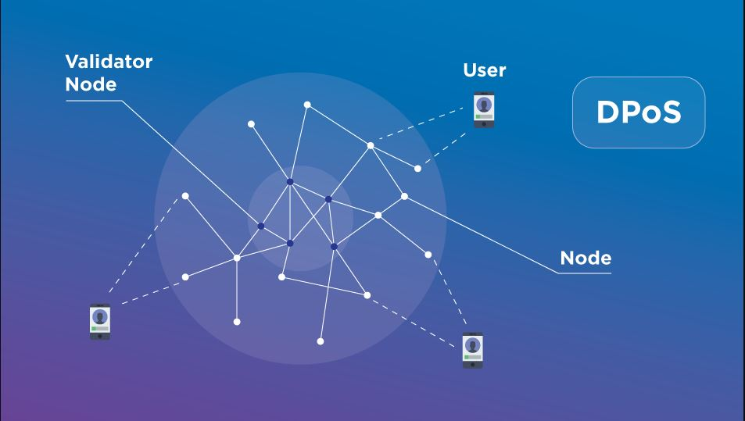
Delegate Proof of Stake (DPoS)
Democratic version of Proof of Stake
Stake holders vote and elect delegates (21 - 101)
Notes:
DPoS - closely resembles PoS with addition of strong community-based factor
Requires community validation of any individual ownership take
Miners of the network vote and elect delegates to validate the next block
Each stakeholder gets no. of votes proportional to no. of coins they own
Delegates take turns producing blocks every few seconds. Each delegate is scheduled to for a specific time slot
Delegates will lose their reputation and will be quickly expelled and replaced by another delegate if he misbehave or constantly fails to produce a block
Benefits:
Faster than PoW and PoS
Miners can perform his role in a truthful way using the incentive he has
Specialized equipment not required
Energy efficient
Higher performance

Slide 35
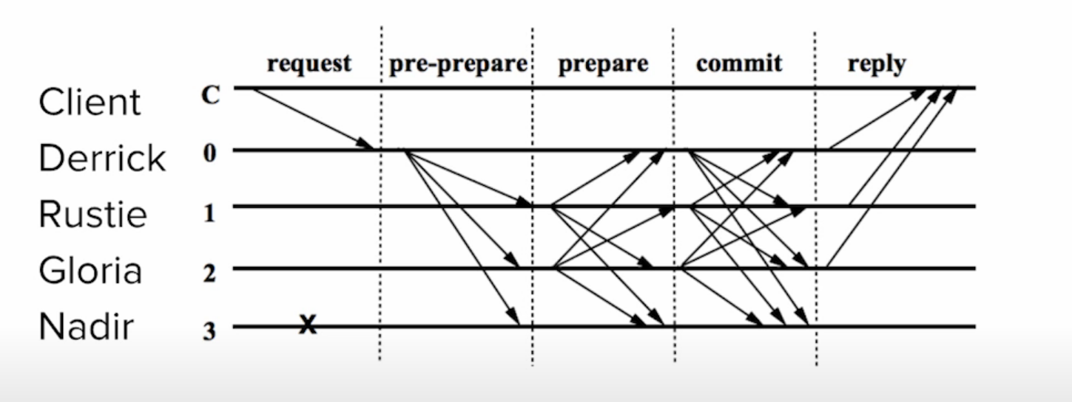
Practical Byzantine Fault Tolerance (PBFT)
Notes:
PBFT - has primary and secondary nodes. The nodes work together to reach a consensus, making the system one of the solutions to the Byzantine General Problem
Can handle 1 fault
How it works:
Client makes a request to the primary node
Primary node broadcasts that request to the secondary nodes
The nodes process the request, provide the service, and respond to the client
The request is served successfully when the client receives “m+1” replies from different nodes in the network with the same result, where m is the maximum number of faulty nodes allowed.
Limitation:
Can only work efficiently only when the number of nodes in the distributed network is small due to high communication overhead that increases exponentially with every extra node in the network.
Messages contain seq no., signatures and useful metadata that lets nodes determine message’s validity
Benefits:
A pBFT doesn’t require carrying out high mathematical computations like PoW.
It is an energy-efficient consensus model.
A block of transactions here does not need to follow multiple confirmations by each node. Hence, it requires less time.
As pBFT requires every node to participate and serves the client request, each node gets the reward. Hence low reward variance between each node.

Slide 36
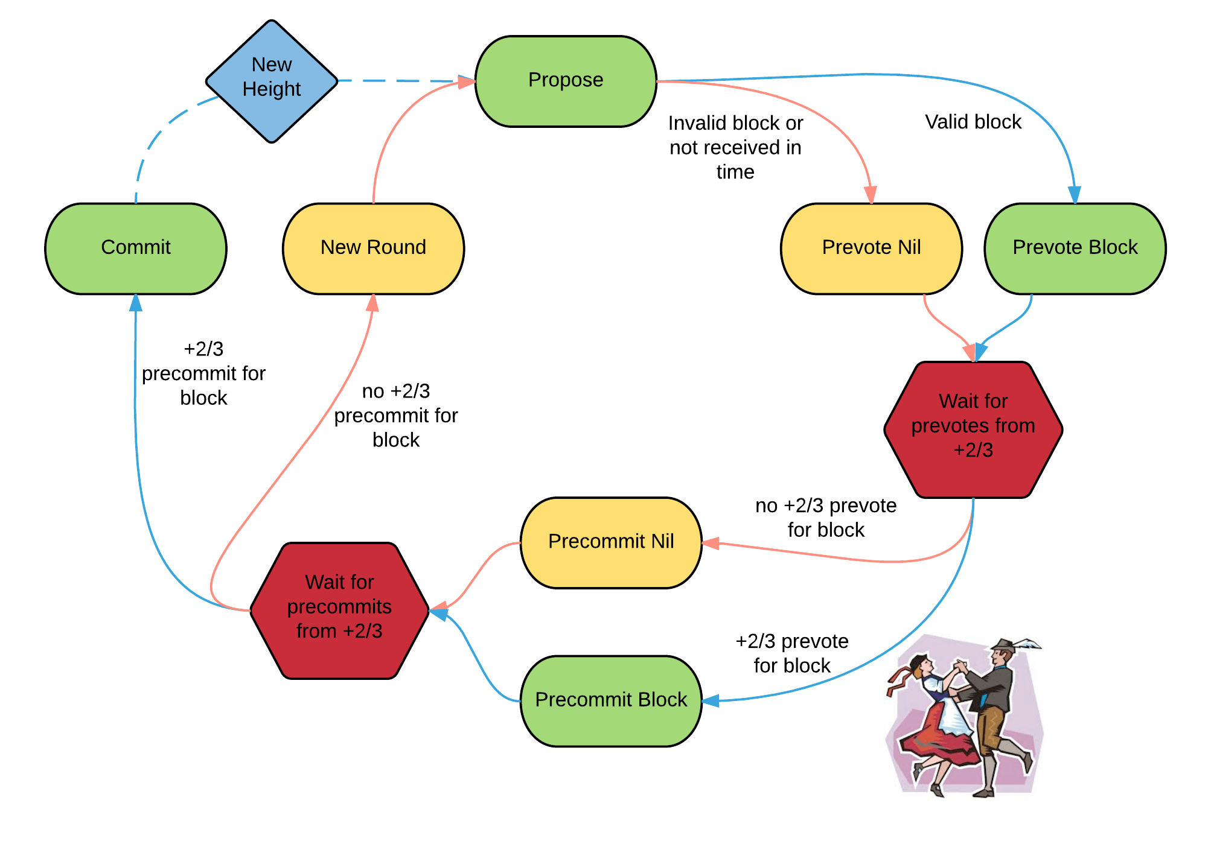
Tendermint
Notes:
Validators take turns proposing blocks of transaction and voting on them.
A block is committed when more than ⅔ of validators pre-commit for the same block in the same round
When ⅔ of the validators pre-commit on the same block it’s called Polka
Reasons of failure to commit a block:
Current proposer is offline
Slow network

Slide 37
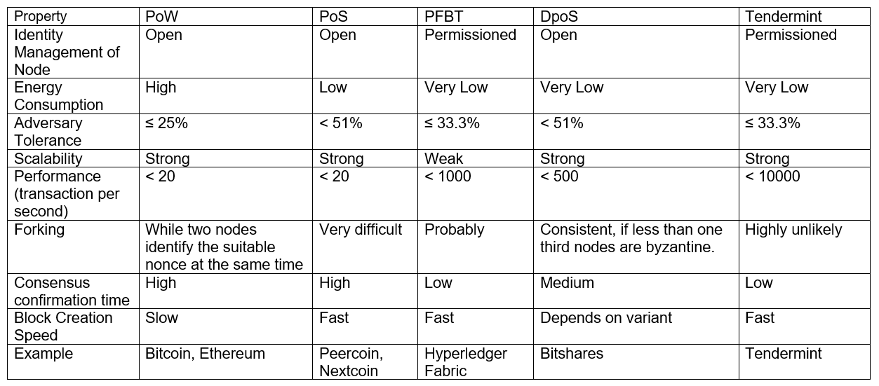
Comparison

Slide 38
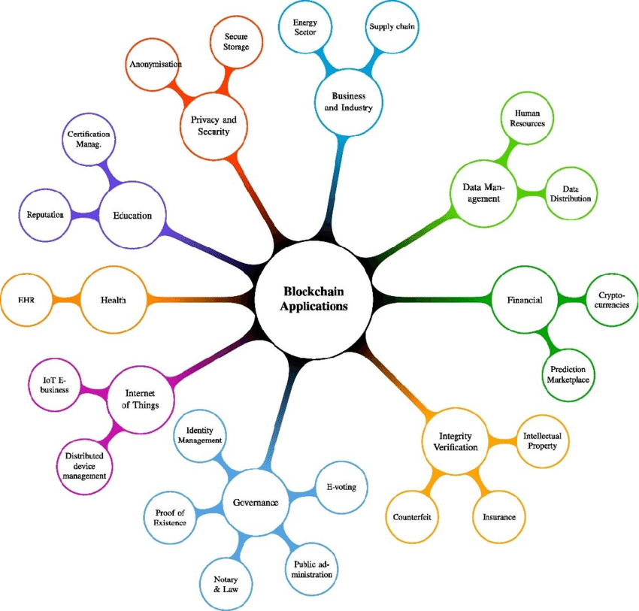
APPLICATION OF BLOCKCHAIN

Slide 39
HEALTH CARE:
Records of the patients.
Provided keys to access data.
DIGITAL VOTING:
Transparent voting monitored by regulators.
One changeable vote per person
DIGITAL IDs:
Create IDs through authenticator app that link with the formal financial sector.
Uses extra layers of protection using codes/tokens to identify users.

Slide 40
DATA SHARING:
Uses blockchain to share/sell unused data.
Unused data bundles routed to places that need it the most.
Marketplace to store data.
COPYRIGHT AND ROYALTY PROTECTION:
Copyright and ownership laws on online media using blockchain to ensure security.
To provide real-time and authentic royalty distribution data to content creators.

Slide 41
THANK YOU !

